Slide 1
IOT-Internet of things
CVSN REDDY
RV University

Slide 2
Table of contents
Introduction to IOT and IOT Boards, IDE
Introduction to Communications and Networking
C to C, C to Arduino, Arduino versus Node MCU
RS-232C,Bluetooth, Wifi, LORA
TCPIP,HTTP,MQTT
Arduino UNO Interface
Serial,Digital, Analog
USART,ADC,PWM
Important Software commands
IOT Data Collection, Data Analysis, Data Visualization, Data Mining
Cloud platforms for storing Arduino Data
LAB Experiments

Slide 3
IOT Introduction and Boards
CVSN REDDY
RV University

Slide 4
What is IoT?
The Internet of Things (IoT) is the network of physical objects or "things" embedded with electronics, software, sensors, and network connectivity, which enables these objects to collect and exchange data.
IoT allows objects to be sensed and controlled remotely across existing network infrastructure, creating opportunities for more direct integration between the physical world and computer-based systems, and resulting in improved efficiency, accuracy and economic benefit.

Slide 5
What are the major components of IoT?
Transducers- Sensors and Actuators
Arduino/NodeMCU(ESP8266)/Rasberrypie
Gateways (Node MCU)
Cloud Platforms
Data warehouse(Web Platforms) and Visualization
Data Analytics Engines(SQL,Hadoop, Storm, Kafka,SQL)
Data Mining(ML,NN and DNN)

Slide 6
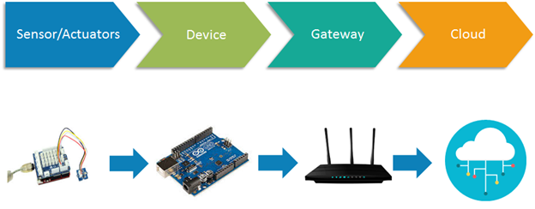
IOT

Slide 7
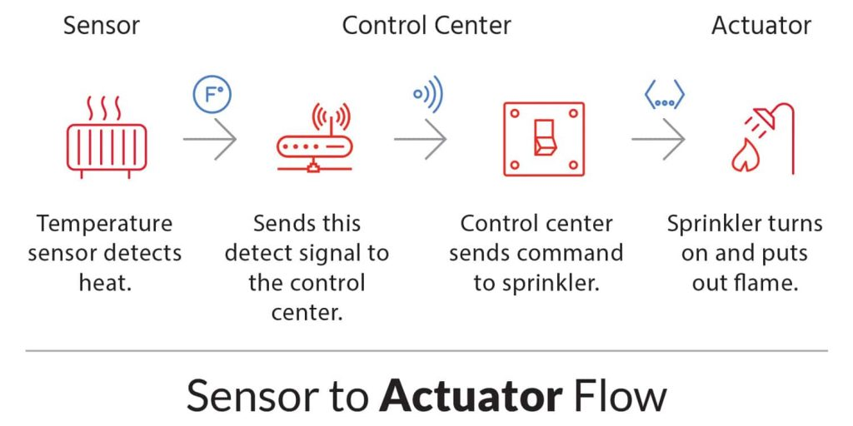
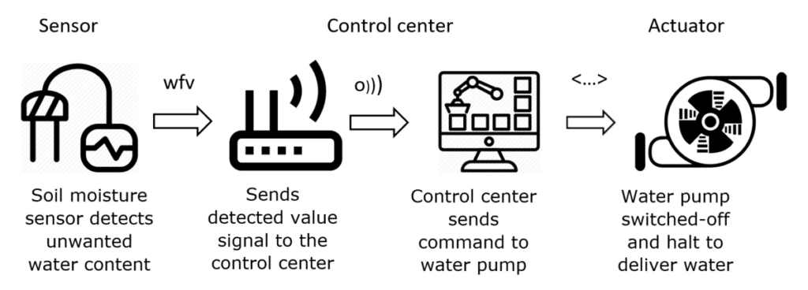
Sensors

Slide 8
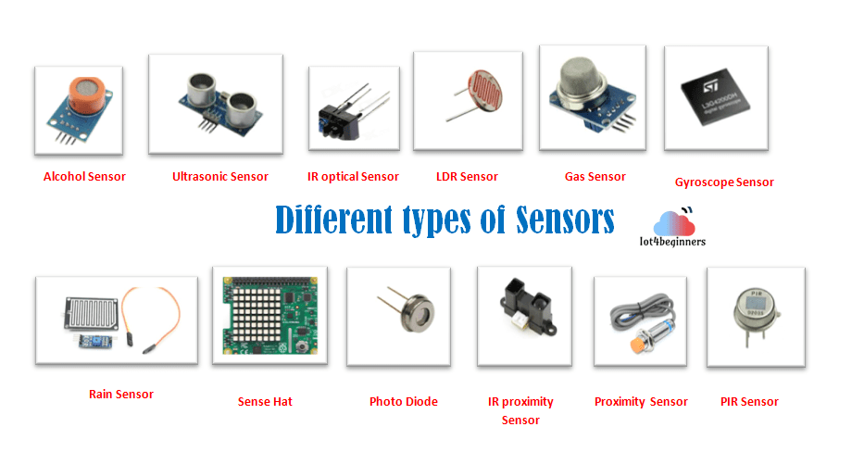
IOT Sensors

Slide 9
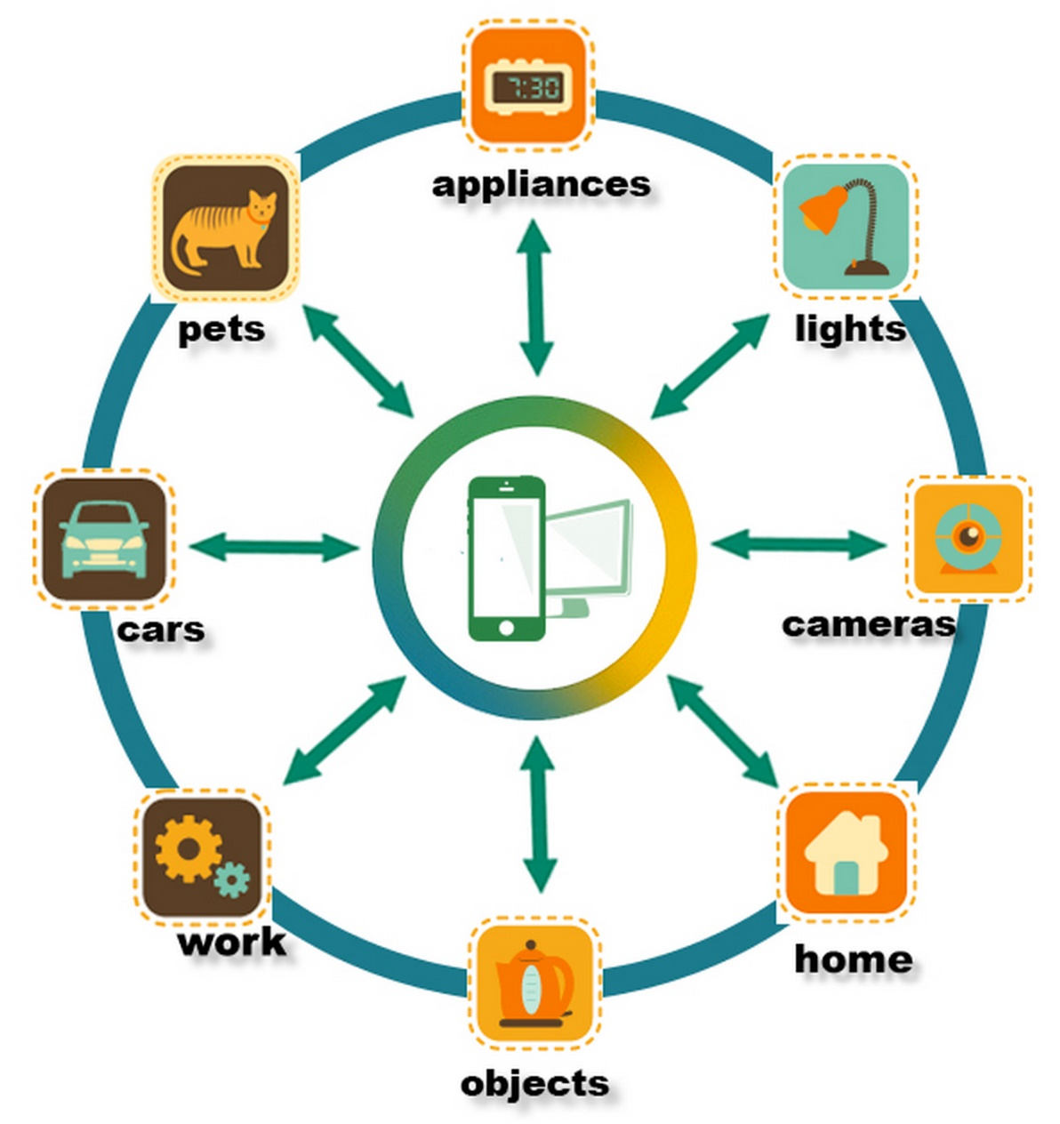
IOT Sensors

Slide 10
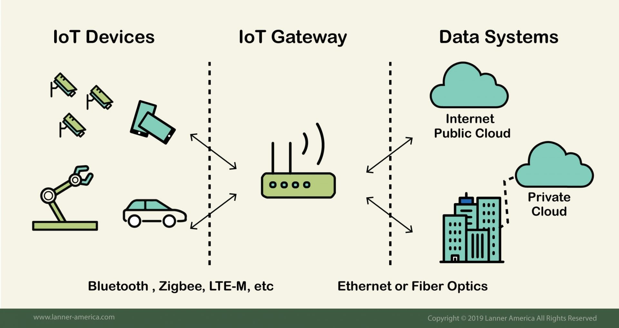
IOT Gateway

Slide 11
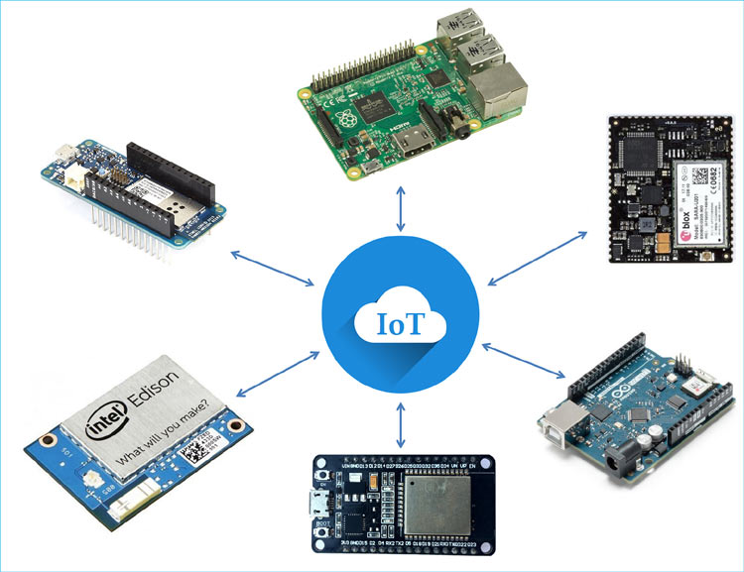
IOT Boards

Slide 12
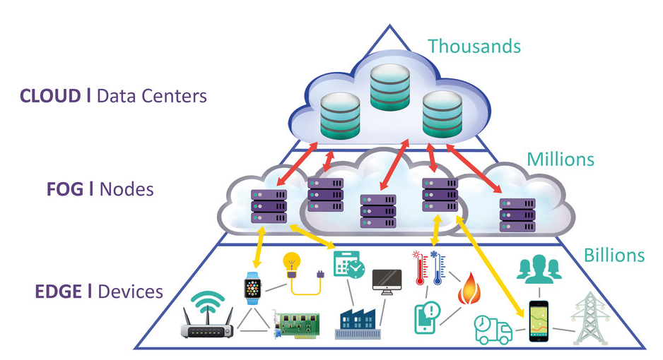
IOT – Edge, FOG, Cloud

Slide 13


Slide 14
IOT HARD ware Details
CVSN REDDY
RV University

Slide 15
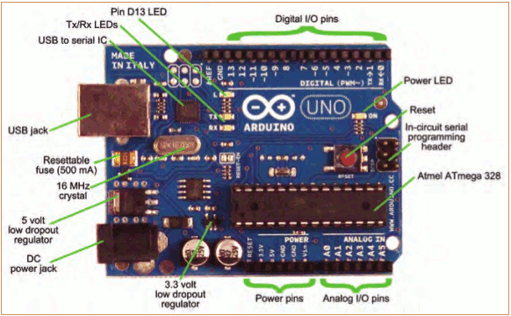
Topic 1: Meet Arduino Uno

Slide 16
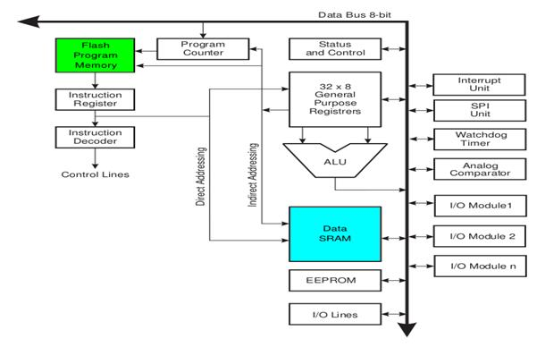
Architecture

Slide 17
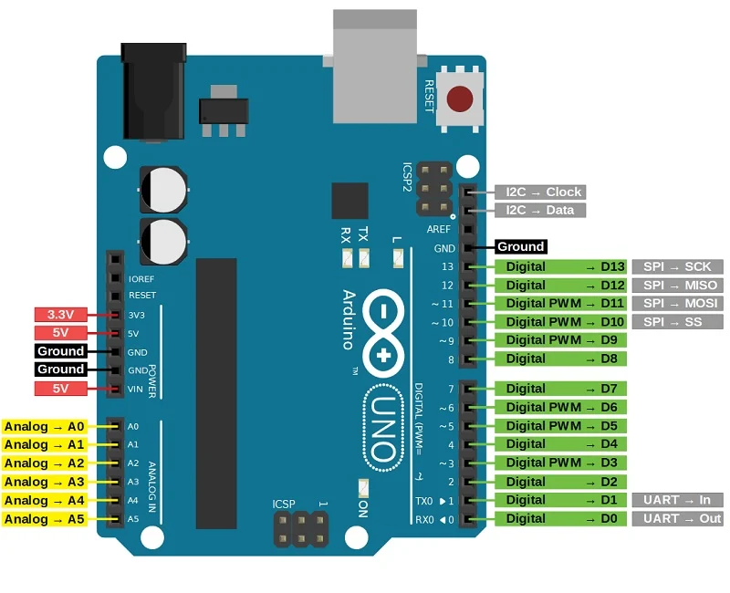
Hardware

Slide 18
Arduino Hardware
Arduino Interface
Serialline
Bluetooth
Wifi
USART- Universal Serial Asynchronous Receiver and Transmitter
ADC – Analog to Digital Converter
PWM – Pulse Width Modulation
The PWM (Pulse Width Modulation) is a method of controlling the average voltage. It is a stream of voltage pulses that reduces the electric power supplied by the electrical signal. The effective voltage is controlled by the width of individual pulses in a stream of voltage pulses of a PWM signal.
COM Port and Baud rate

Slide 19
IOT - Communications
CVSN REDDY
RV University

Slide 20
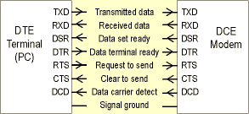
Computer to computer communication
Computer to Computer Communication (RS-232C)

Slide 21
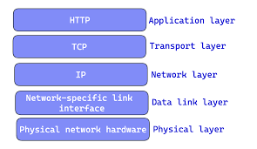
TCP-IP Stack

Slide 22
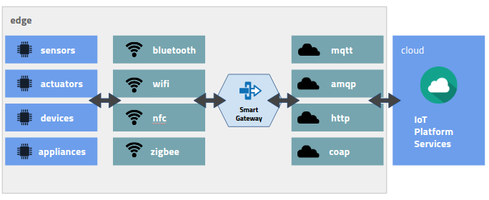
IOT Protocols

Slide 23
Communication Technologies for IoT
Bluetooth
Zigbee
Z-Wave – Home automation
6LowPAN
Thread – Home automation
NFC (Near-Field Communication) - Creditcard
RFID
WiFi
2G/3G/LTE/5G
Sigfox
LoraWAN

Slide 24
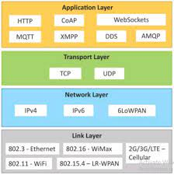
IOT stack and Web stack

Slide 25
Getting Started
Check out: http://arduino.cc/en/Guide/HomePage
Download & install the Arduino environment (IDE) (not needed in lab)
Connect the board to your computer via the USB cable
If needed, install the drivers (not needed in lab)
Launch the Arduino IDE
Select your board
Select your serial port
Open the blink example
Upload the program

Slide 26
IOT – Arduino IDE
CVSN REDDY
RV University

Slide 27
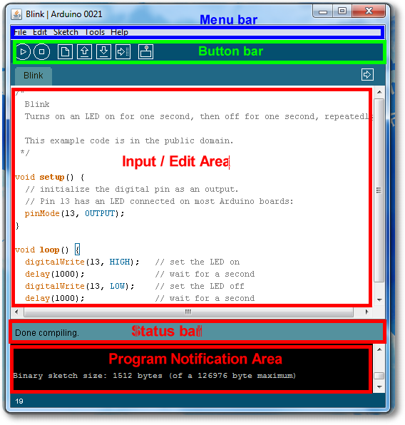
Arduino IDE
See: http://arduino.cc/en/Guide/Environment for more information

Slide 28
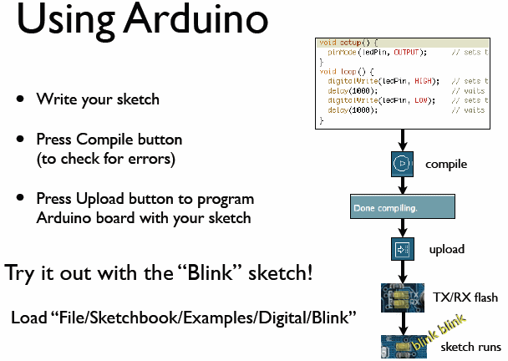
todbot.com/blog/bionicarduino

Slide 29
Arduino Digital I/0
pinMode(pin, mode)
Sets pin to either INPUT or OUTPUT
digitalRead(pin)
Reads HIGH or LOW from a pin
digitalWrite(pin, value)
Writes HIGH or LOW to a pin
Electronic stuff
Output pins can provide 40 mA of current
Writing HIGH to an input pin installs a 20KΩ pullup
Notes:
29

Slide 30
Analog IO
analogRead() reads the value from an analog pin.
analogWrite() writes an analog value to a pin

Slide 31
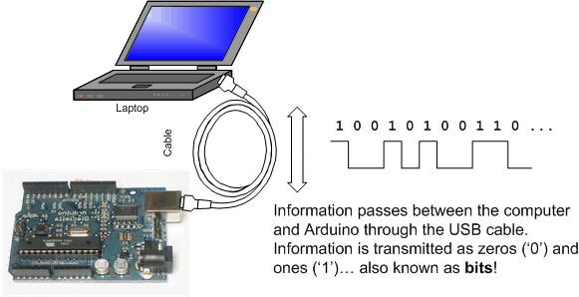
Topic 4: Serial Communication
Image from http://www.ladyada.net/learn/arduino/lesson4.html

Slide 32
Serial Commands
Serial.begin()
- e.g., Serial.begin(9600)
Serial.print() or Serial.println()
- e.g., Serial.print(value)
Serial.read()
Serial.available()
Serial.write()
Serial.parseInt()

Slide 33
Digital IO
digitalRead() reads the value from a digital pin. Accepts a pin number as a parameter, and returns the HIGH or LOW constant.
digitalWrite() writes a HIGH or LOW value to a digital output pin. You pass the pin number and HIGH or LOW as parameters.
pinMode() sets a pin to be an input, or an output. You pass the pin number and the INPUT or OUTPUT value as parameters.
pulseIn() reads a digital pulse from LOW to HIGH and then to LOW again, or from HIGH to LOW and to HIGH again on a pin. The program will block until the pulse is detected. You specify the pin number and the kind of pulse you want to detect (LHL or HLH). You can specify an optional timeout to stop waiting for that pulse.
pulseInLong() is same as pulseIn(), except it is implemented differently and it can’t be used if interrupts are turned off. Interrupts are commonly turned off to get a more accurate result.
shiftIn() reads a byte of data one bit at a time from a pin.
shiftOut() writes a byte of data one bit at a time to a pin.
tone() sends a square wave on a pin, used for buzzers/speakers to play tones. You can specify the pin, and the frequency. It works on both digital and analog pins.
noTone() stops the tone() generated wave on a pin.

Slide 34
Time Functions
delay() pauses the program for a number of milliseconds specified as parameter
delayMicroseconds() pauses the program for a number of microseconds specified as parameter
micros() the number of microseconds since the start of the program. Resets after ~70 minutes due to overflow
millis() the number of milliseconds since the start of the program. Resets after ~50 days due to overflow

Slide 35
Interrupts
noInterrupts() disables interrupts
interrupts() re-enables interrupts after they’ve been disabled
attachInterrupt() allow a digital input pin to be an interrupt. Different boards have different allowed pins, check the official docs.
detachInterrupt() disables an interrupt enabled using attachInterrupt()

Slide 36
Control statements and Libs
If-else
Switch, For
Maths functions
Random generator
Bit operations

Slide 37
IOT – Data Collection , data Analysis, data Visualization,Data Mining
CVSN REDDY
RV University

Slide 38
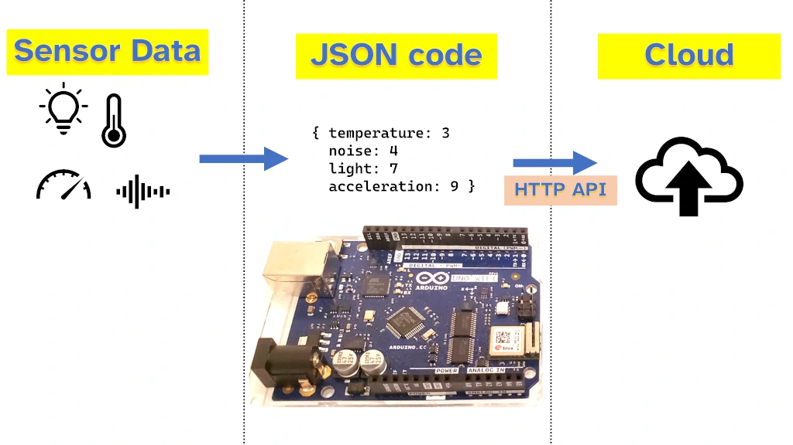
IOT Cloud

Slide 39
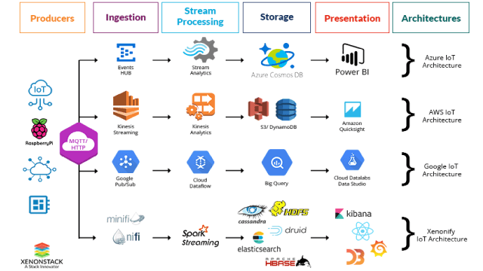
IOT private cloud Frame works

Slide 40
IOT Public CLOuD Frame works
An Arduino can send data to the cloud for free using JSON over HTTP or by sending data via MQTT.
Cloud providers that accept this data from an Arduino include
Pantry Cloud, JSONSty, JSON Bin, npoint, and the official Arduino IoT service.
An Arduino can also save data with paid cloud providers such as Google Cloud, Amazon AWS, and Microsoft Azure.

Slide 41
Expectations from Project
Understand Requirements
Analyse requirements
Prepare SRS Docuement
Design
Code
Test
Test Document with Test Cases
Demo

Slide 42
BIG Thanks
CVSN REDDY
RV University

Slide 43
Digital READ
int pButton=2; void setup() { Serial.begin(9600); pinMode(pButton,INPUT); } void loop(){ int bState=digitalRead(pButton); Serial.println(bState); delay(5000); }

Slide 44
Digital write
void setup() {
pinMode(13, OUTPUT); // sets the digital pin 13 as output
}
void loop() {
digitalWrite(13, HIGH); // sets the digital pin 13 on
delay(1000); // waits for a second
digitalWrite(13, LOW); // sets the digital pin 13 off
delay(1000); // waits for a second
}

Slide 45
Serial Programs-https://binaryupdates.com/serial-communication-in-arduino-uno/
Example Program 1: In this example, we will send a string from Arduino to PC. Once we upload the sketch into Arduino. We will see this string will be printing on Serial Monitor Window of Arduino IDE.
void setup()
{
Serial.begin(9600);
}
void loop()
{
Serial.println("Hello from Umesh");
delay(1000);
}

Slide 46
int inByte; // Stores incoming command
void setup()
{
Serial.begin(9600);
pinMode(13, OUTPUT); // Led pin
Serial.println("Type 1: LED ON, 0: LED OFF "); // Ready to receive commands
}
void loop()
{
if (Serial.available() > 0)
{ // A byte is ready to receive
inByte = Serial.read();
if (inByte == '1') { // byte is '1'
digitalWrite(13, HIGH);
Serial.println("LED - On");
} else { // byte isn't '1'
digitalWrite(13, LOW);
Serial.println("LED - off");
}
}
}

Slide 47
References
https://roboticsbackend.com/arduino-uno-pins-a-complete-practical-guide/

